Slide 1


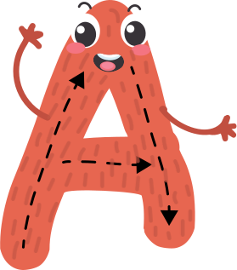
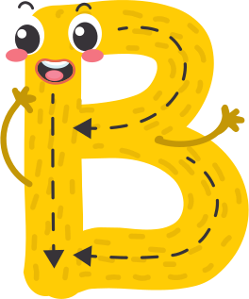
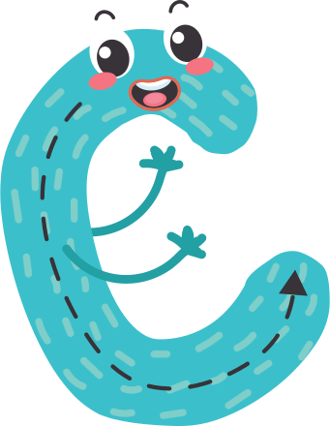
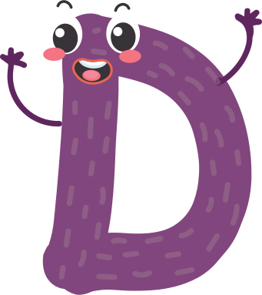
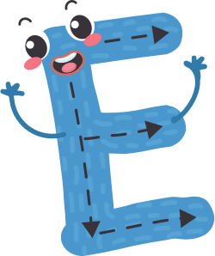
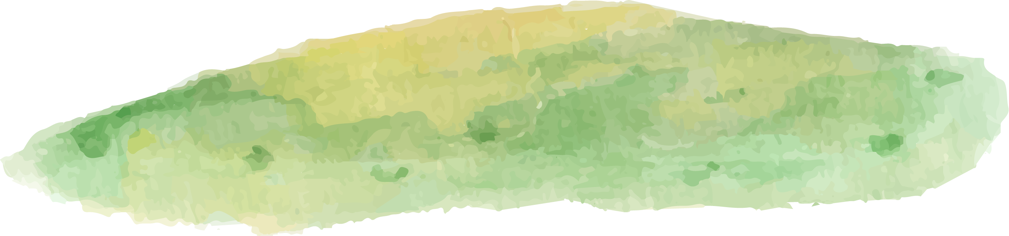
KVS Exam Teaching Video
LEARNING ALPHABET

Slide 2
Today, we are going to learn about the alphabet. Your teacher will show each letter on the screen. Read it out loud and think about words that start with that letter.

Slide 3
LETTER A
Can you think of things that start with the letter A?

Slide 4
LETTER B
Who can come up with words that start with the letter B? Raise your hand!

Slide 5
LETTER C
Let's explore things that begin with the letter C. Can you name any?

Slide 6
LETTER D
Can you come up with as many words as you can that start with the letter D?

Slide 7
LETTER E
Who can come up with words that start with the letter E? Raise your hand!

Slide 8

LETTER F
Let's brainstorm! What are some objects that start with the letter F?

Slide 9
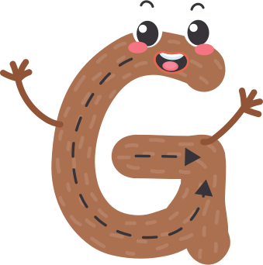
LETTER G
I spy with my little eye, something that starts with the letter G. Can you guess what it is?

Slide 10
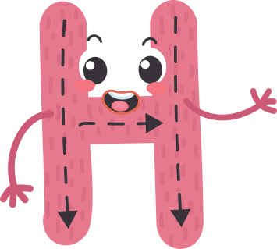
LETTER H
Our mission is to find words that start with the letter H. Who's up for the task?

Slide 11
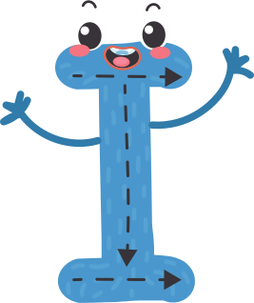
LETTER I
Imagine a world full of things that start with the letter I. Can you share some examples?

Slide 12
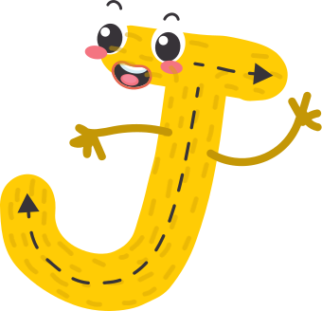
LETTER J
Get your thinking caps on! We're on a quest to discover words that begin with the letter J. Any ideas?

Slide 13

LETTER K
Calling all word detectives! Your mission, if you choose to accept it, is to uncover words that start with the letter K. Who's up for the challenge?

Slide 14
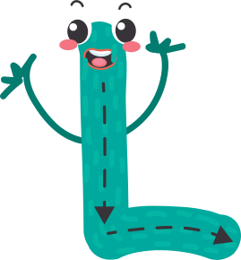
LETTER L
Let's play a guessing game! I'm thinking of a word that starts with the letter L. Can you guess what it is?

Slide 15
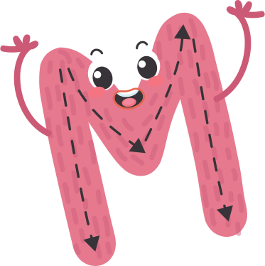
LETTER M
Let's dive into the letter M! Who can come up with some words that start with this amazing letter?

Slide 16
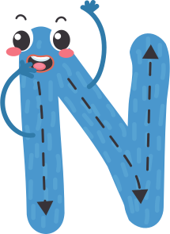
LETTER N
Do you have a word radar? We're searching for words that start with the letter N. Can you detect any?

Slide 17

LETTER O
Get your word engines revved up! We're on a quest to gather words that begin with the letter O. Ready, set, brainstorm!

Slide 18

LETTER P
Calling all creative minds! We need your help to invent words that start with the letter P. Let your imagination run wild!

Slide 19
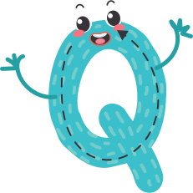
LETTER Q
Quick! We need your help to think of words that start with the letter Q. Time is ticking. Can you do it?

Slide 20

LETTER R
Are you ready to embark on a word hunt? Let's search for words that start with the letter R. Who will find the most?

Slide 21
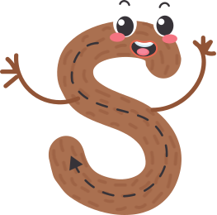
LETTER S
Listen closely! I'm going to say a letter, and your job is to shout out as many words as you can that start with it. Ready? S!

Slide 22

LETTER T
Let's put our thinking caps on and come up with words that begin with the letter T. Who has an idea?

Slide 23
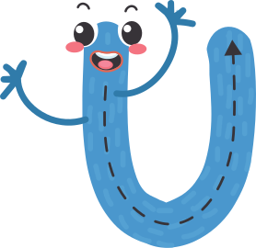
LETTER U
Let's play the U-word game! Who can come up with the most amazing words that start with this tricky letter?

Slide 24

LETTER V
Attention, young linguists! Our task is to explore the letter V and uncover its magical words. Who's up for the challenge?

Slide 25

LETTER W
It's time to brainstorm! What are some objects that start with the letter W?

Slide 26

LETTER X
Are you ready for a challenge? See if you can think of words that start with the letter X!

Slide 27

LETTER Y
Challenge time! Can you brainstorm words that start with the letter Y? Let's see how many you can come up with!

Slide 28
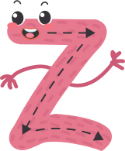
LETTER Z
Imagine you're in a magical land of words, and the door to that land opens with the letter Z. What words can you find?

Slide 29
WELL DONE!

